Slide 1
Chemical Reactions Balancing Chemical Equations

Slide 2
Changes
Change usually comes in two forms:
PHYSICAL
Physical change occurs when only the form or shape of the matter changes but the composition stays the same (it looks different but contains the same atoms & molecules).
CHEMICAL
Chemical change occurs when the composition of a substance changes into a different substance (the molecules & atoms change into different molecules).

Slide 3
6 Indicators of a Chemical Change
In your study of matter, you learned that there are three ways to determine if there was a chemical change; a change in the composition of a substance.
Recall, they were…
Change in color
Production of a gas
Formation of a precipitate
In total, there are 6 indicators of a chemical change; three more to truly be inclusive of a chemical change.
Production of light
Change in temperature (heat or cold)
Obvious change in mass

Slide 4
Energy & Change
The necessary ingredient of change is energy.
Energy is the ability to move or change matter.
You studied two major kinds of energy
Kinetic = the energy of motion
Potential = stored energy
Luckily, energy is all around us and exists in many forms.
It can be converted from one form to another & with enough education you can cause this conversion yourself, on purpose.
This is what Chemists do!

Slide 5
Chemical Reactions

Slide 6
Chemical Reactions
Changing a substance, chemically, requires a chemical reaction.
During a chemical reaction, bonds between atoms are broken and new ones are formed.
There are two participants of a reaction
A reactant (aka substrate) is a substance that is changed in a chemical reaction
It’s all the stuff that you start with that mixes and mingles together.
A product is a new substance that is formed.
This is the stuff that you end up with after the mingling.

Slide 7
Reactants to Products
You will see numerous chemical reactions in science.
They are written in the same form:
Reactants → Products
The arrow means “changes to” or “forms”
Sometimes the arrow only goes one way and sometimes the arrow goes both ways.
When the arrow goes both directions it shows you that the reactants and products can switch positions… that the reaction can go both directions.

Slide 8
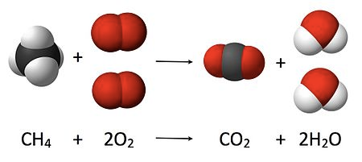
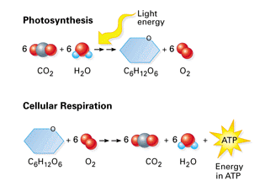
Chemical Reaction

Slide 9
Types of Chemical Reactions
Taken from the Law of the Conservation of Matter, atoms in a chemical reaction are neither created nor destroyed.
They are simply rearranged in several ways to give us the three major categories of chemical reactions.
Synthesis: when two or more atoms are bonded together to make something bigger.
Decomposition: when a larger substance is chemically broken down into different smaller parts.
Replacement: When atoms from one reactant are taken away and re-bonded with other reactants in the reaction to make a new product.

Slide 10
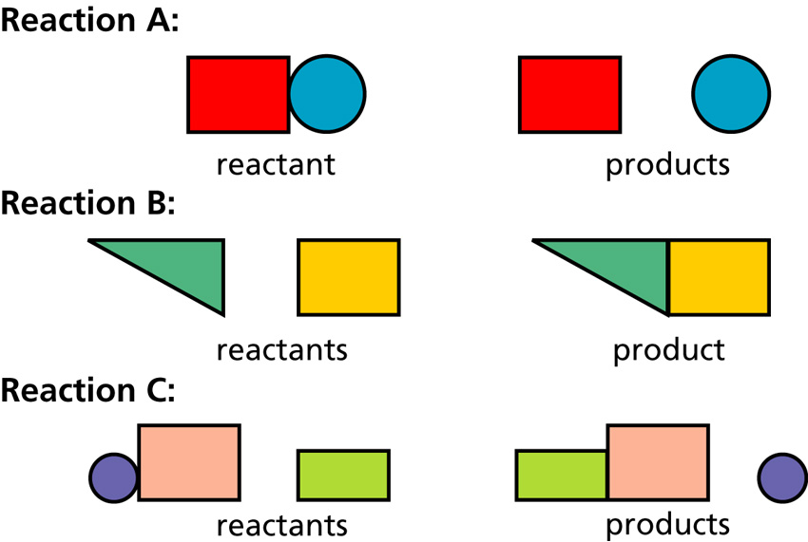
Models of Reactions
The following drawings represent reactants and products of three different chemical reactions.
Which model represents which reaction type?
Which letter represents the…
Replacement reaction?
Decomposition reaction?
Synthesis reaction?

Slide 11
Chemical Reactions and their Equations.
In a chemical reaction, products combine, rearrange, or break down into different products, but the starting number of atoms in the reactants must equal the number of atoms in the products.
Chemical Equations help us ensure the proper amounts of atoms are accounted for in a reaction.
Therefore, a chemical equation is a written, balanced representation of a chemical reaction.

Slide 12
Examples of Chemical Equations
6CO₂ + 6H₂O → C₆H₁₂O₆ + 6O₂ Sunlight energy
6CO₂
Reactants and products in a chemical equation are represented as formulas which identify the elements involved in and their quantities.
This helps us identify the numbers of atoms invovled, as well as helps us make sure all atoms are accounted for in the products.

Slide 13
Chemical Equations
Let’s look at this part of the equation for photosynthesis, how plants convert carbon dioxide gas and water into glucose sugar and oxygen gas.
6CO₂ + 6H₂O → C₆H₁₂O₆ + 6O₂ Sunlight energy
6CO₂
Formulas: A chemical reaction is broken down into terms, called formulas. The formulas of a chemical reaction are separated by the + signs.
In this reaction, there are 2 reactant terms and 2 product terms. The formulas represent the bonded molecules or compounds required or created in a reaction.

Slide 14
Breaking Down Formulas in Chemical Equations
Let’s look at this part of the equation for photosynthesis, how plants convert carbon dioxide gas and water into glucose sugar and oxygen gas.
6CO₂ + 6H₂O → C₆H₁₂O₆ + 6O₂ Sunlight energy
6CO₂
Coefficient: You identify the quantity of the bonded molecules/ compounds by the number in front of the formula.
Subscript: You identify the quantity of the elements involved in the molecule/compound by the little number hanging from the bottom.
You identify the elements involved by looking at the capital letters which represent the element symbols.

Slide 15
Your Goal: Balancing Basic Chemical Reactions
In order to create products, chemists use chemical equations like cooks use recipes.
Chemists decide what they want to create and how much of it then either know, search out, or create a chemical equation that will give the proper reaction.
They gather the materials, add the necessary energy, and conduct a process for the products to form.
These reactions can be found, but your goal is to apply the Law of Conservation of Matter and balance equations.
Luckily, there are steps to follow to make this happen.

Slide 16
Let’s Practice!
Using the “Balancing Act” worksheet, let’s balance the given equation.
____Mg + ____O₂ → ____ Mg O
Reactants | Elements | Products
Start with what’s given to determine the number of atoms for each element. USE A REP TABLE.
Pick an element that is obviously not equal on both sides of the equation.
Add a coefficient in front of the formula with that element and adjust your counts.
Continue adding coefficients to get the same number of atoms of each element on each side.

Slide 17
Finished Product
Easy, right?!
2Mg + (1) O₂ → 2 Mg O

